Slide 1
Our Context
Virtual team:
  Team members in different locations
  Time zone difference
Cross cultural:
  Different languages
  Different cultures
Consequences:
  Have to manage communication
  Have to manage language and cultural barriers
  Trust is more fragile

Slide 2
Causes of Problems in Virtual Teams
Communication issues
Ambiguity
Loss of trust
Fears (crainte) of meeting expectations and goals
“Share the pain” !
Engager un expert en Virtuals Teams

Slide 3
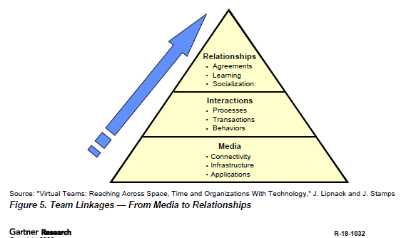
Issues Facing Virtual and Cross-Cultural Teams

Slide 4
Mitigating Communication Obstacles
Between 60% and 80% of the communication is non-verbal (lost in a virtual team environment)
The divergence/convergence cycle is natural for the virtual team
Over communicate:
  Verbalization (same level of comprehension)
  Reflection (everyone feels that progress is being made)
  Ask questions
Combine the media:
  ZOOM, TEAMS
  TelePresence System
  E-mail
  E-room
  Desktop sharing utilities

Slide 5
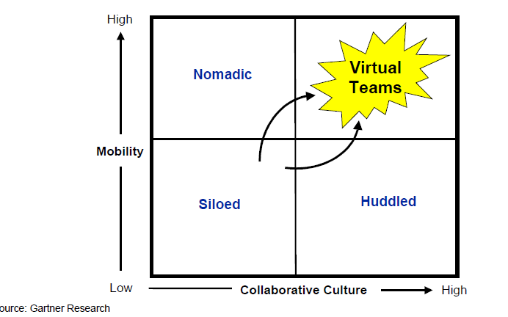

Collaboration and Mobility Drive Virtual Teams
=BI
(Nomade)
(se blottir)

Slide 6
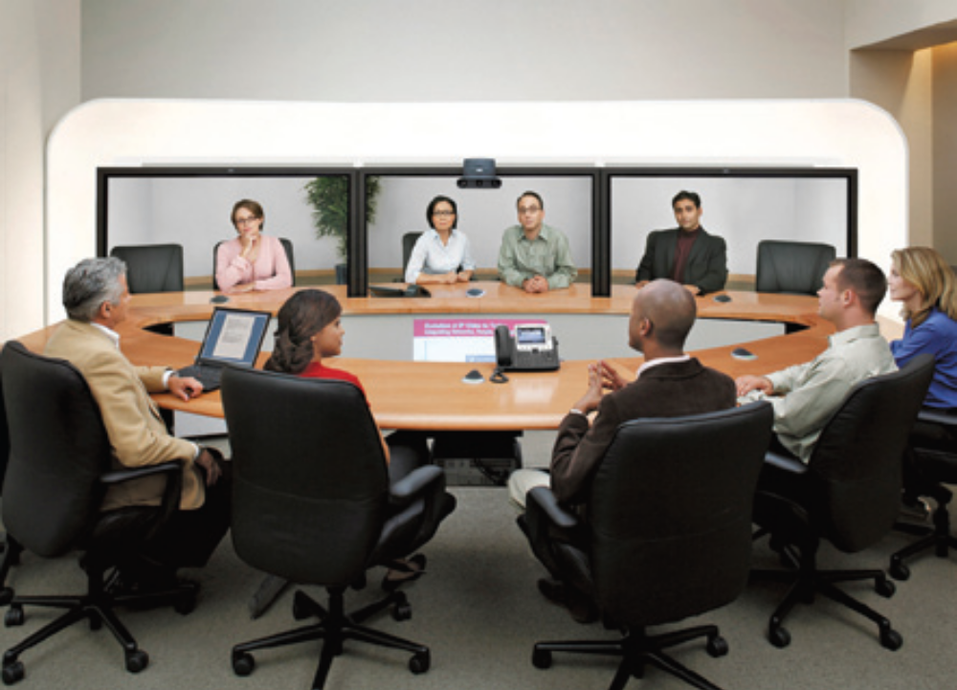
Cisco TelePresence System TP3010:
The existing Rio Tinto Installations use the top end configuration (both device and room specification)

Slide 7
Installation Options:
Three different units available
System Attributes | TP1100 | TP1300 | TP3010
Seats | 2 | 6 | 6
Screens | 1 | 1 | 3
Cameras | 1 | 3 | 3
Content Sharing | Presentation in Picture | Presentation in Picture | Below Screen on separate LCD

Slide 8
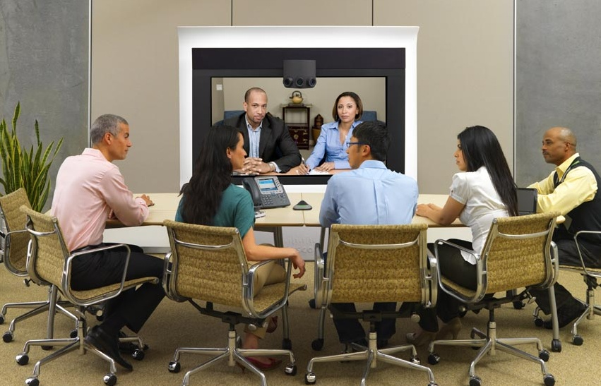
Cisco TelePresence System TP1300

Slide 9
Indicative Cost Comparison
Implementation Charges | TP1100 | TP1300 | TP3010
Equipment – | $ 65,000.00 | $ 68,000.00 | $ 170,000.00
TelePresence Installation | $ 45,000.00 | $ 49,000.00 | $ 90,000.00
VNOC/Concierge setup | $ 3,000.00 | $ 3,000.00 | $ 3,000.00
Implementation Program Management (based in Australia) | $ 39,000.00 | $ 39,000.00 | $ 90,000.00
 | $152,000.00 | $ 159,000.00 | $353,000.00
Room Treatment cost (indicative) | $ 50,000.00 | $ 50,000.00 | $ 275,000.00
Annual Charges ( 5 Year Term) | TP1100 | TP1300 | TP3100
Service Management | $ 11,700.00 | $ 11,700.00 | $ 11,700.00
White Glove per annum – plus In-country taxes | $ 6,000.00 | $ 6,000.00 | $ 9,300.00
Maintenance per annum | $ 26,000.00 | $ 28,000.00 | $ 65,000.00
VNOC/Concierge per annum | $ 49,200.00 | $ 49,200.00 | $ 49,200.00
Network link carriage per annum | $ 54,000.00 | $ 66,000.00 | $ 84,000.00
 | $146,900.00 | $160,900.00 | $219,200.00
NOTE: Costs are indicative only. Taxes, charges, exchange rates, etc will vary from country to country.
A precise quote from IBM is required to get a number sufficient for implementation;
Network link costs are also highly variable.
A separate link must be used (the Telepresence traffic cannot be carried over RioNet).

Slide 10
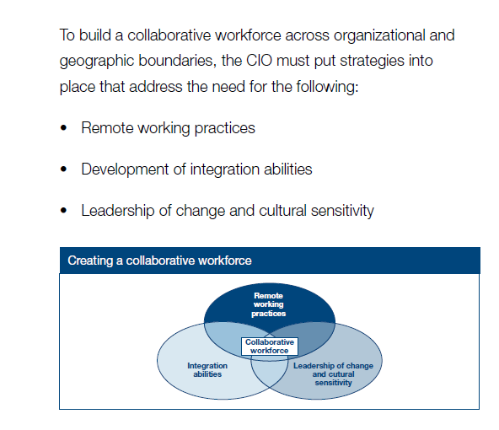

Slide 11
Mitigating Cultural/Language Differences
Cultural diversity can be leveraged to become an advantage
Avoid jokes, expressions, colloquialisms, acronyms. If cannot be avoided:
  Explain the meaning
  Document (create paper trail)
Speak slower and clearer

